Slide 1
Sentimental Analysis of reviews
Batch A8
Guide Name: Dr. T RAGHUNADHA REDDY
Members:
Padamati Jashwanth Reddy(16881A1233)
D.Ram Charan(16881A1212)
Srirangam Pradeep(16881A1250)

Slide 2
PROBLEM STATEMENT
In the present day situation we have very less time to know the review of any large video. For example consider any educational video which is of duration more than an hour. For knowing the review of the video would take more time to know the review of that particular video. This is the problem being faced by many end users which encouraged us to take up this issue and give a solution to it.

Slide 3
OBJECTIVE OF PROJECT
The main objective of the project is to develop a prototype of Sentiment Analysis Reviewer using technologies, namely, Flask, Selenium and Text Blob . Sentiment Analysis Reviewer can discover and extract the reviews associated with any online Youtube Video Link. It can answer complex queries for knowing the review of the video and thus assist the users to make intelligent decisions which traditional decision support systems cannot. By providing effective review, it also helps to reduce the time taken to know the review of the video. To enhance visualization and ease of interpretation, it displays the results in graphical forms.

Slide 4
EXISTING SYSTEM
There are systems which use scraping content from the website using Selenium, Beautiful Soup and so on, but there is no system which is used for giving review to the scrapped content.

Slide 5
PROPOSED SYSTEM
As the problem statement describes the problem for which we came up with a solution where the end users will be getting the review of the YouTube video for which the end user wants to know the review. For this we consider the YouTube video link given by the end user and open that video in separate window and start scraping the content of the video. Here we scrap the comments, likes and dislikes which helps us to give the review report. For this we used the technologies like Flask, Selenium and Text blob.

Slide 6
Technologies Used:
Flask
Selenium
Text Blob

Slide 7
Flask
Flask App routing. App routing is used to map the specific URL with the associated function that is intended to perform some task. It is used to access some particular page like Flask Tutorial in the web application.

Slide 8
Selenium
Selenium is one of the most widely used open source Web UI (User Interface) automation testing suite. Selenium supports automation across different browsers, platforms and programming languages.
Selenium can be easily deployed on platforms such as Windows, Linux, Solaris and Macintosh. It supports a variety of programming languages through the use of drivers specific to each language. Languages supported by Selenium include C#, Java, Perl, PHP, Python and Ruby. Currently, Selenium Web driver is most popular with Java and C#. Selenium test scripts can be coded in any of the supported programming languages and can be run directly in most modern web browsers. Browsers supported by Selenium include Internet Explorer, Mozilla Firefox, Google Chrome and Safari.

Slide 9
Text Blob
Text Blob is a Python library for processing textual data. It provides a simple API for diving into common natural language processing (NLP) tasks such as part-of-speech tagging, noun phrase extraction, sentiment analysis, classification, translation, and more. It stands on the giant shoulders of NLTK and pattern, and plays nicely with both.

Slide 10
IMPLEMENTATION STEPS
Step1: We need to run the python file using interpreter. Then open the corresponding page in the any of the browser. The page will be loaded using the script.
Step2: Open the front end website and the user needs to give the youtube video link in the input box. The open.html will be the important application to take the input and process the output.

Slide 11
IMPLEMENTATION STEPS (cntd.)
Step3: After successful submission the given youtube video link gets opened in other tab then the execution goes to the python script again, executes the code under route “/res”.
Step4: In the execution the URL will be received and stored under the url variable. Then the driver for chrome is initialized. Then the drive runs the URL with a sleep time of 5 sec.

Slide 12
IMPLEMENTATION STEPS (cntd.)
Step5: Once the URL is runned the chrome is opened and ran at the server side. The scroll takes place using the Selenium with a sleep time of 5 sec. This Selenium technology will allow us to scrap the website contents dynamically by scrolling down after the given sleep time. So, once the sleep time is done the website will be scrolled down eventually. As the comments will be more we are limiting the scraping to 10 iterations. Once the iterations are done the scraping gets stopped.
Step6: For every comment converting into text.For that text find sentiment polarity and update respective values. Once the sentiment polarity is done the bar graph is displayed.

Slide 13
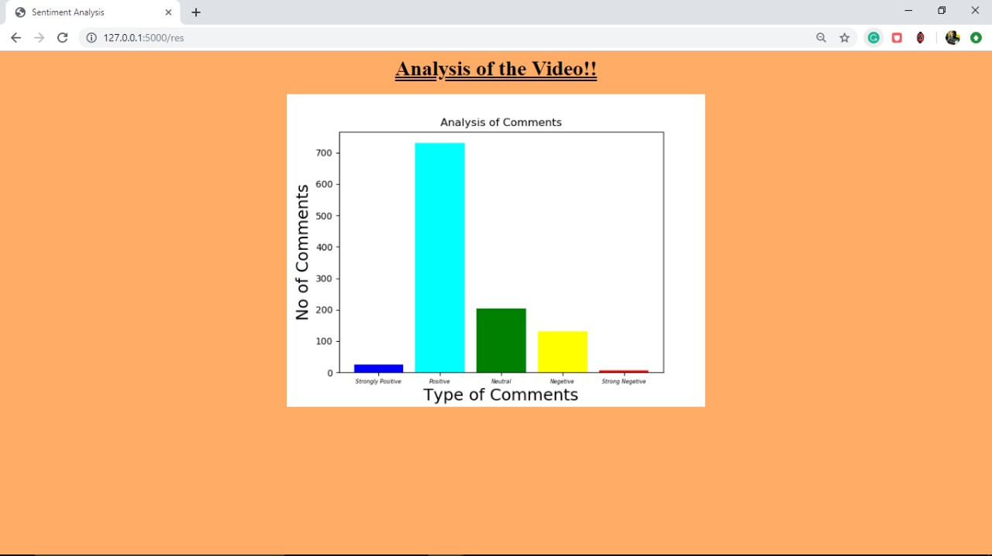
Output Screen

Slide 14


Slide 15


